Slide 1
http://www.youtube.com/watch?v=YcNOapwgw6I

Slide 2
Adolescence Is a Time of Change
During the teen years, the hormonal & physical changes of puberty lead to an awakening of sexual feelings.
It’s common to wonder and sometimes worry about new sexual feelings.

Slide 3
Takes time for people to understand who they are & who they are becoming.
Greater understanding of their own sexual feelings & who they are attracted to.

Slide 4
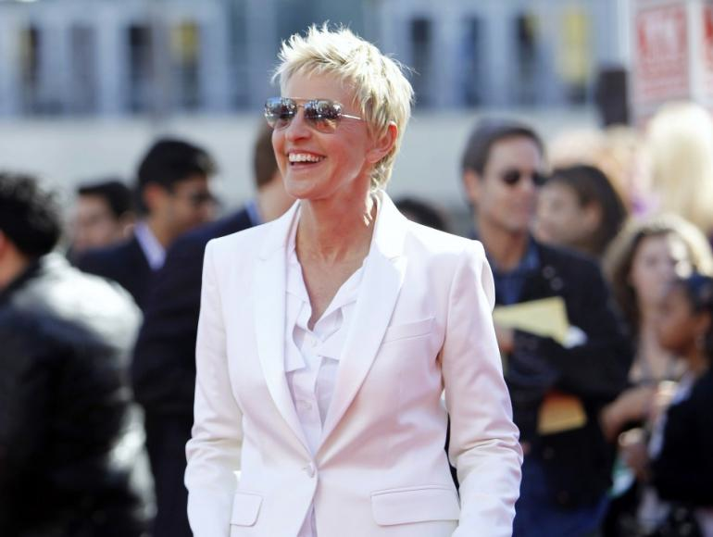

Slide 5
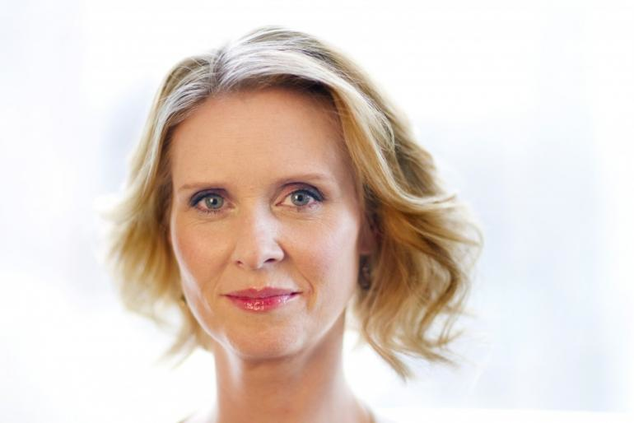

Slide 7
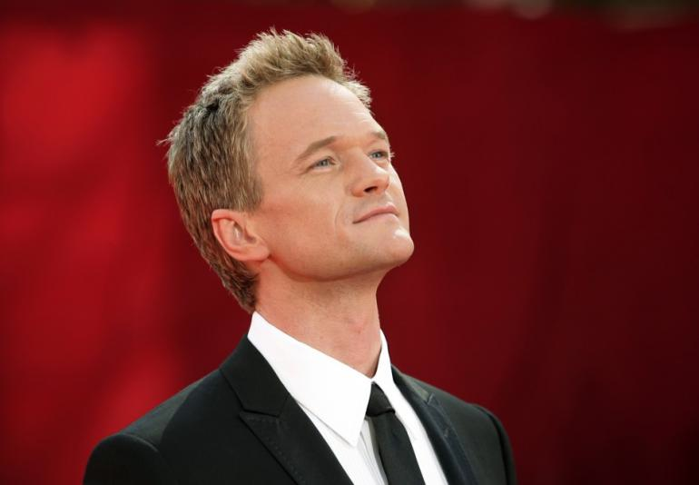

Slide 9
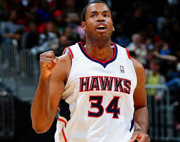

Slide 10
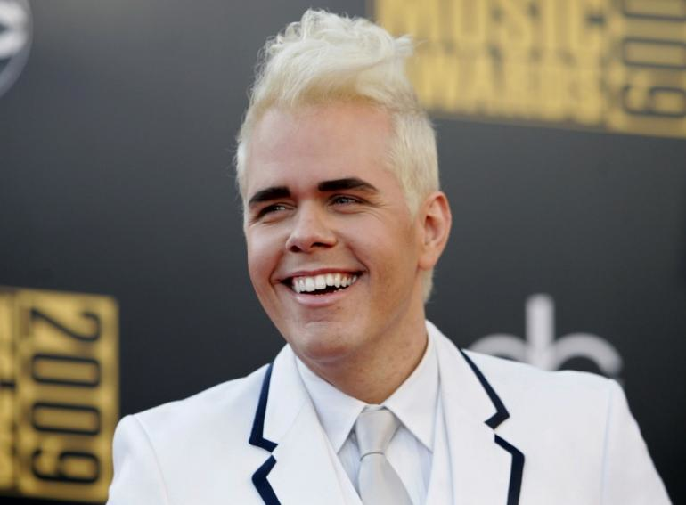

Slide 11
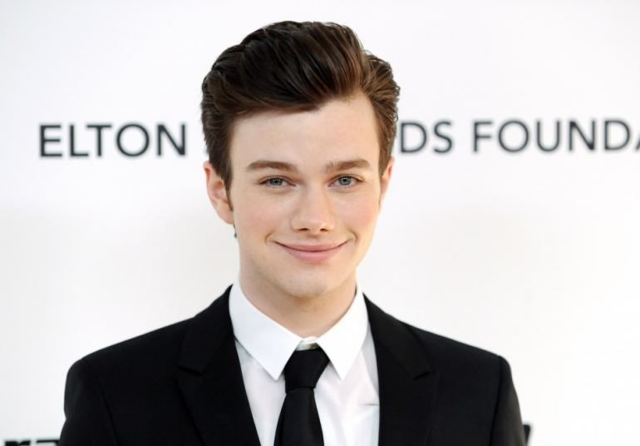

Slide 13
“Agender”, “third- gender”, “bigender” –identity somewhere between woman and man.
Gender identity- how you, in your head, think about yourself being either female or male.
Formed by the age of 3 and incredible difficult to change after that.
Formation of identity affected by hormones & environment just as much as biological sex.

Slide 14
Article:
Canadian Parents Raise Gender-Neutral Baby by Not Revealing Its Sex

Slide 15
As you know it, do you think you fit better into the society role of “woman,” or “man,” or do neither ring particularly true for you? That is, are you somewhere in-between the two? Or do you consider your gender to fall outside of the spectrum completely?
The answer is your GENDER IDENTITY

Slide 16
“Androgynous”- mixed form of expressing gender.
Demonstrate by the ways you act, dress, behave, and interact- whether intentional or unintended.
Changes from day to day, outfit to outfit, event or setting to event or setting

Slide 17
How does the way you express yourself align or doesn’t with “traditional” ways of expression?
You slide around on a continuum throughout the week without even knowing it!

Slide 18
“Hermaphrodite”, “intersex”- someone whose sex organs are not strictly male or female.
Biological sex refers to the objectively measurable organs, hormones, and chromosomes your possess.

Slide 19
Female- having a vagina, ovaries, two X chromosomes, predominantly estrogen, and you can grow a baby in your stomach.
Male- having testes, penis, an XY chromosome, predominantly testosterone, you can put a baby in a female’s stomach area.
Intersex- any combination of both.

Slide 20
Sexual Orientation- who you are physically, spiritually, and emotionally attracted to.

Slide 21
Heterosexual. Attracted to people of the opposite sex, or being straight.
Homosexual. Attracted to people of the same sex, or being gay or lesbian.
Bisexual. Attracted to people of both sexes.
Asexual. Lack of sexual attraction to others, as it doesn’t fit into the continuum.

Slide 22
Interrelation vs. Interconnection
Gender Identity, Gender Expression, Biological Sex, and Sexual Orientation are NOT CONNECTED.

Slide 23
Not Connected?
People’s sexual orientation does not determine gender expression.
Gender expression isn’t determined by gender identity.
Gender identity isn’t determined by biological sex.
They AFFECT one another, but are not determined by one another.

Slide 24
Identity “cisgender”
When your biological sex aligns with how you identify.
Example: If someone is born with male reproductive organs and genitalia, he is very likely to be raised a boy, identify as a man, and expresses himself masculine.
Grants your privileges in society. What does this mean to you?

Slide 25
What does it stand for?
LGBT
LGBTQ

Slide 26
It stands for…
“Lesbian, gay, bisexual, and transgender”.
“Lesbian, gay, bisexual, transgender, questioning”.

Slide 27
What Does It Mean to Be Transgender?

Slide 28
Transgender boy returns to school in Edmonton, proudly sharing his story
http://www.thestar.com/news/canada/2013/09/02/transgender_boy_returns_to_school_in_edmonton_proudly_sharing_his_story.html

Slide 29
Do People Choose their Sexual Orientation?

Slide 30
What’s It Like for LGBT Teens?

Slide 31
The Importance of Talking

Slide 32
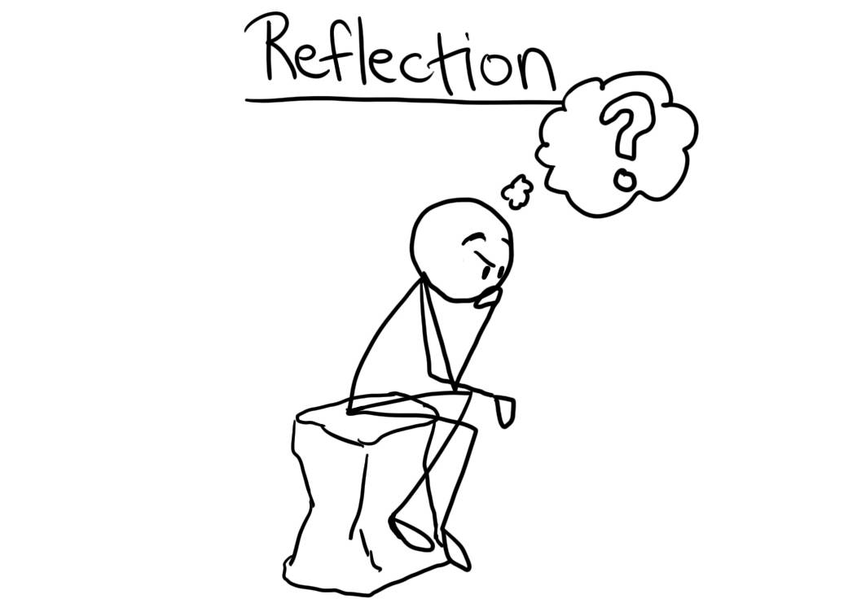

Slide 33
Reflection: As a teen, what are some ways a student who is struggling with their sexual orientation could do to help them feel comfortable with their self-identity? (/4)

