Slide 1
Vocabulary Words
For Food Safety

Slide 2
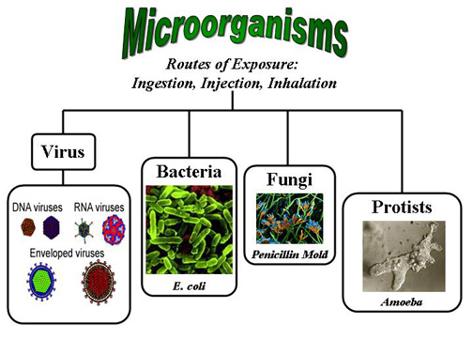
Microorganism
Tiny single celled organism that can only be seen with the microscope
Example: yeast, bacteria, mold, viruses and parasites

Slide 3
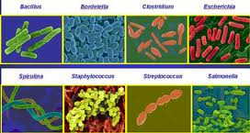
Pathogen
Harmful microorganism that can make people sick

Slide 4
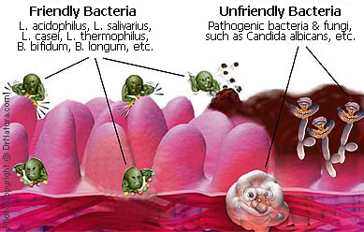
Bacteria
Microorganism that can be either harmful or helpful

Slide 5
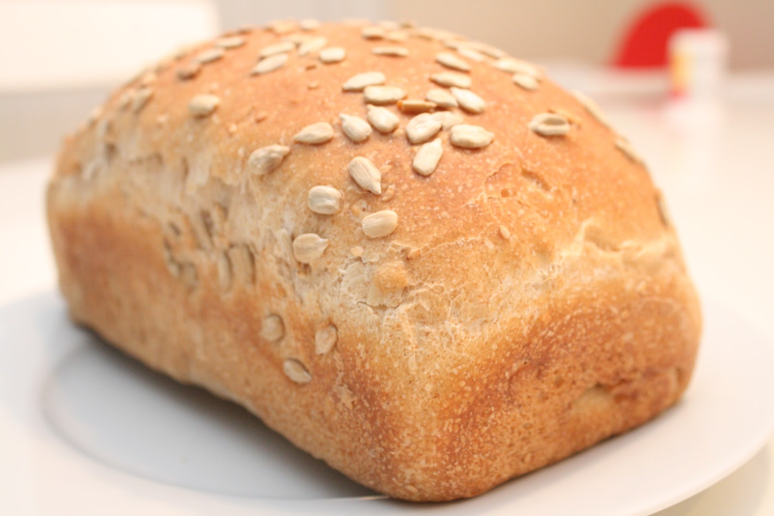
Yeast
Microorganism that allow bread to rise but can cause other foods to spoil

Slide 6
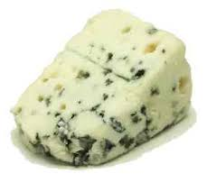
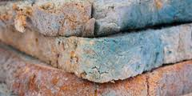
Molds
Microorganisms that cause fuzzy growths on cheese and bread

Slide 7
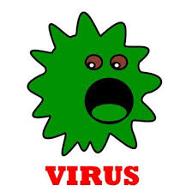
Viruses
Smallest living organism.
Example: Hepatitis A

Slide 8
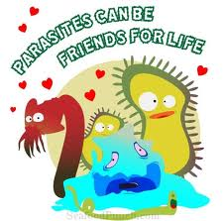
Parasites
Tiny, microscopic animals such as amoebas

Slide 9
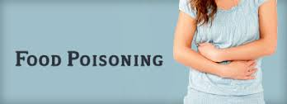
Food-born illness
Sickness caused by ingesting pathogens in food

Slide 10
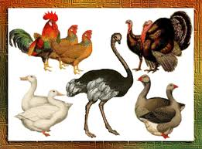
Salmonella
Bacteria that live on chicken and other types of poultry

Slide 11
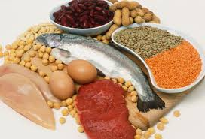
Clostridium perfringens
Bacteria known to live in high protein foods

Slide 12
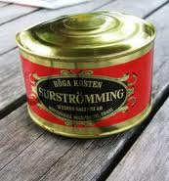
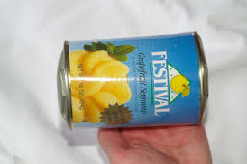
Clostridium botulinum
A bacteria that can live with out oxygen
Found in canned goods and causes them to bulge or dent

Slide 13
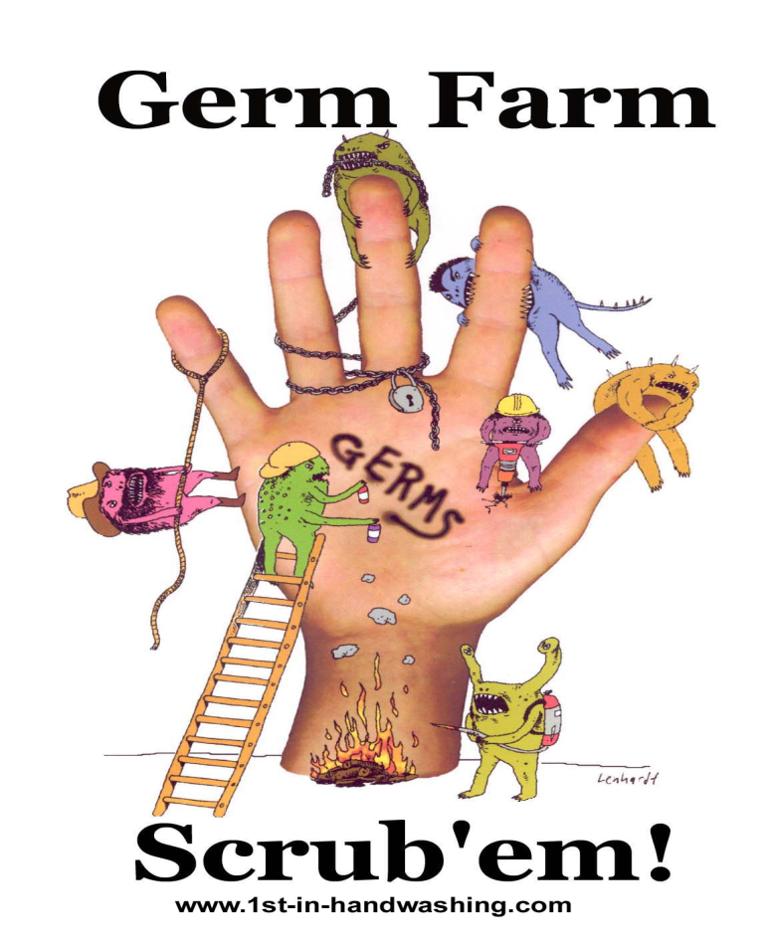
Staphylococcus aureus
Bacteria that can live on the skin or hands
Can get into food if you forget to wash your hands

Slide 14
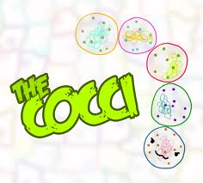
Cocci
A round shaped bacteria

Slide 15
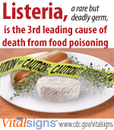
Listeria monocytogenes
Bacteria that can grow in the refigerator

Slide 16
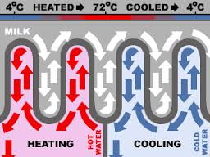
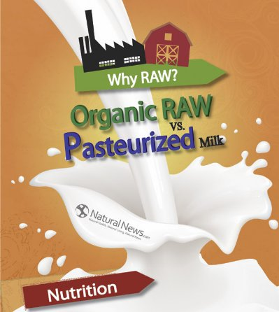
Pasteuization
Heating a food to a high temperature at a short time to kill bacteria
Milk

