Slide 1
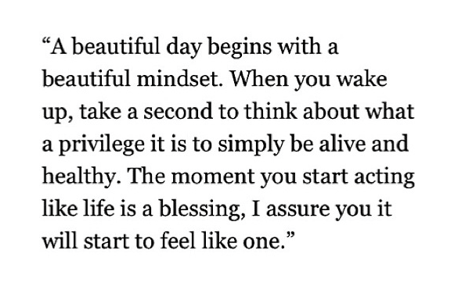

Slide 2
Being Proactive, Emotional Intelligence & Empathy

Slide 3
The Time You Have In Jellybeans Video
http://elitedaily.com/life/motivation/this-video-uses-jelly-beans-show-you-how-much-youre-wasting-your-life-video/

Slide 4
Activity
Write down a list of 10 things you REALLY want to do but feel you do not have the “time” to do it.
What strategies are you going to put in place to ensure you are able to do these 10 things you REALLY want to do.
What will you “give up” to create the time needed.
HAND IN

Slide 5
How Can I Become More Proactive?
Your life doesn’t just “happen”.
You CHOOSE happiness, sadness, decisiveness, success, failure, courage, fear, etc.
Each situation provides you with a new choice.
How are you going to do things to produce more positive results?
Notes:
http://www.wikihow.com/Be-Proactive

Slide 6
5 Habits of Highly Effective People

Slide 7
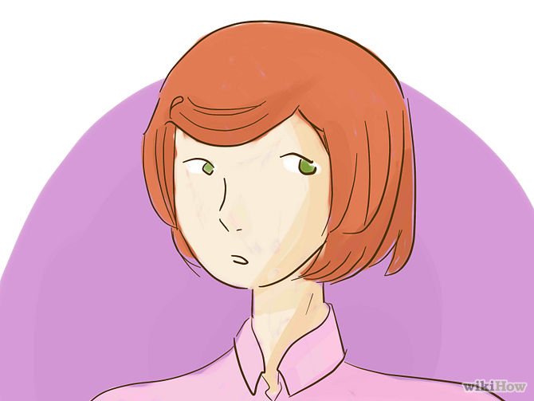
Habit 1: BE PROACTIVE, NOT REACTIVE.
Taking responsibility for your life.
DON’T BLAME everything on your genetics, circumstances, conditions, or conditioning for your behavior.
You have the freedom to choose your response and behavior.
Focus time and energy on things you can control.

Slide 8
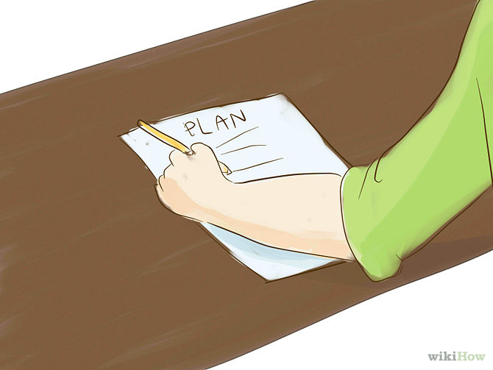
Habit 2: Begin With The End In Mind
Use your imagination! What does this mean?
Envision with your mind…
All things are created twice:
MENTAL (first creation)
PHYSICAL (second creation)
Connect with what makes you unique by defining your values and what makes you happy.
Otherwise you may give other power to shape your circumstances without even knowing it.
Create your own Personal Mission Statement.
This makes you the leader of your own life.

Slide 9
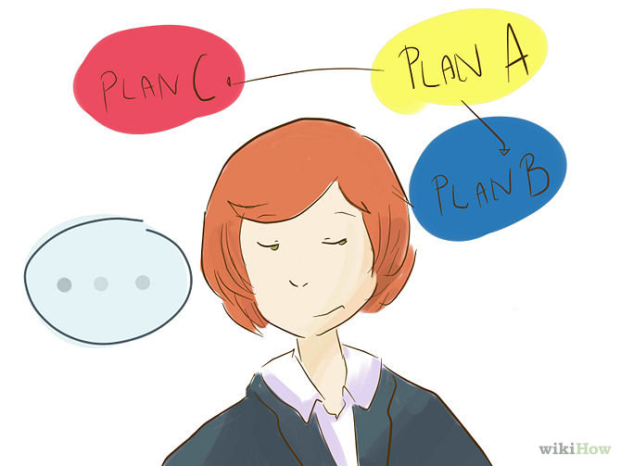
HABIT 3: PUT FIRST THINGS FIRST
Focus on your HIGHEST priorities.
“You are IN CHARGE, you are the CREATOR.”
Ask yourself: “What is my purpose, values, roles, and priorities?”
What do you personally find of most worth?
Then, manage your time and event according to those personal priorities.

Slide 10
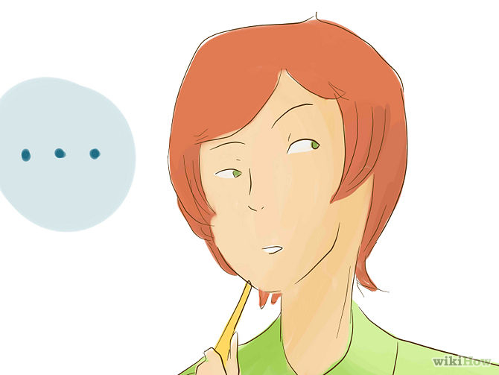
HABIT 4: THINK, “TWO HEADS ARE BETTER THAN ONE”
Be open- minded, seek finding new solutions to old problems.
People bring all their personal experiences and expertise to the table.
Process of gaining new insight.
Differences are strengths, not weaknesses.

Slide 11
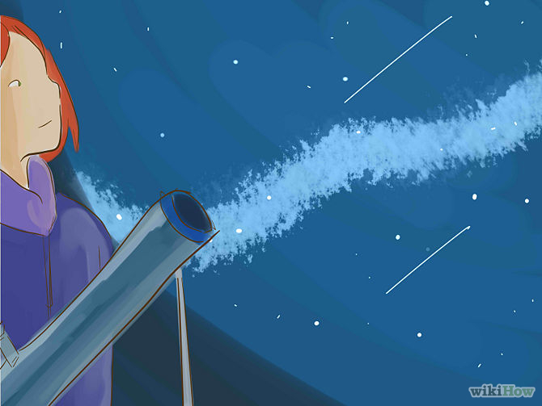
HABIT 5: TAKE CARE OF YOURSELF
Maintain balance.
PHYSICAL: beneficial eating, exercising, and resting.
SOCIAL/ EMOTIONAL: Making social and meaningful connections with others.
MENTAL: Learning, reading, writing, and teaching.
SPIRITUAL: Spending time in nature, expanding spiritual self through meditation, music, art, prayer, or service.

Slide 12
Self- Awareness is…
What does this mean to you?
“ongoing attention to one’s internal states.”
- Daniel Goleman

Slide 13
Emotional Intelligence
An ability to notice our true feelings leaves us at their mercy. People with greater certainty about their feelings are better pilots of their lives, having a surer sense…about personal decisions from whom to marry to what job to take.
- Daniel Goleman
Our ability to recognize what we are feeling when we are feeling it.
- Daniel Goleman
Notes:
Identifying and being with your feelings.

Slide 14
Activity: Your “Observer Self”
Draw a picture of mountain.
Think of 4 scenarios that spike your emotions.
What spikes your emotions?
What gets you to the top of the mountain, what brings you back down?
What brings you back down?
How fast does it take you to get back down?

Slide 15
Rachel & Robert p. 227 “Calling in the One”
Key words:
Emotional attunement
Empathy
Why do you think these 2 aspects are important in a healthy relationships?

Slide 16
The ability to properly read one’s own feelings, to manage them by self- soothing or delaying reactions to a certain degree, and then to understand and respond appropriately to the feelings of others.
Notes:
It doesn’t mean we have to know why we are feeling it, or whether it is good or bad. The important thing is that we can identify that feeling in that moment so we can share it with another person in a constructive way.
It is about honoring those feelings.

Slide 17
The Power of Empathy (3 min)
Activity and discussion: Brainstorm (in groups of 3 or 4) on a poster paper the differences between empathy and sympathy.
You can provide scenarios you think you encounter in your life.
http://www.youtube.com/watch?v=1Evwgu369Jw

Slide 18
Empathy fuels connection.
Sympathy drives disconnection.

Slide 19
4 Qualities of Empathy:
= “Feeling with people”
Perspective taking
Staying out of judgment
Recognizing emotion in other people
Communicating that emotion with them

Slide 20
Turning Adversity into Opportunity
http://www.gettheguy.co.uk/blog/turning-adversity-into-opportunity-interview-with-kathy-eldon/

